Slide 1
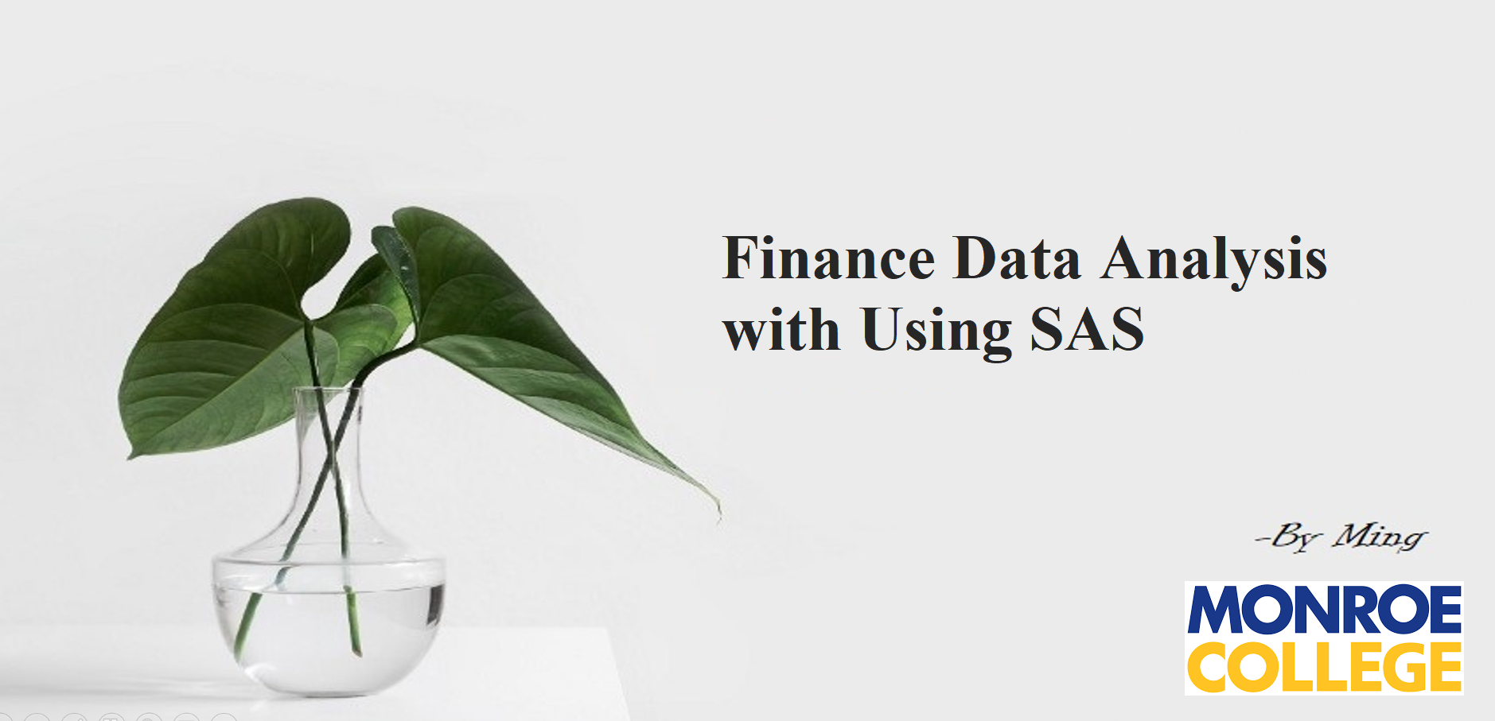

Slide 2
PRO TIMESERIES

Slide 3
PRO TIMESERIES

Slide 5
1995 – 2022 FINANCE DATA ANALYSIS WITH USING SAS FROM

Slide 13
1995 – 2022 FINANCE DATA ANALYSIS WITH USING SAS FROM

Slide 14
THANK YOU FOR WATCHING!

